Slide 2

Autobook
Schedule your life tomorrow, today

Slide 3
What is Autobook?
An Android app
Merges all your smartphone interactions into one application
Allows you to schedule automatic communication through social media & text messaging
Examples: Congratulate your friends on their birthday, Tweet at your brother on his anniversary, or message all the friends an hour before the party to remind them, ALL PLANNED IN ADVANCE SO YOU DON’T HAVE TO TOUCH ANYTHING!

Slide 4
UI Design - Preston

Slide 5
UI Implementation – Sebastian

Slide 6
OAuth/Twitter - Kenton

Slide 7
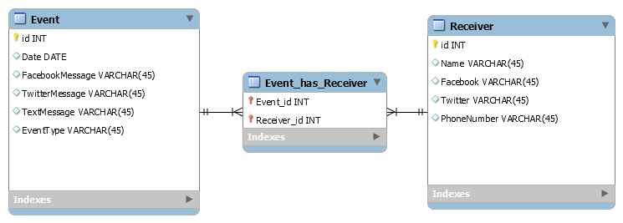
Database - Anders
SQLite database created using the SQLiteOpenHelper class and is stored locally on the mobile device.
All queries to the database are done though the class MyDatabaseHandler which simplifies the inputs needed to do a query and does some basic data manipulation to make the data easily readable by other parts of the system.
Database does not support all CRUD commands for every table yet. The next features to be implemented after/during spring break is the ability the update existing rows in the different tables.

Slide 8
Upcoming Changes
From now till the open house

Slide 9
The Updated Schedule
Task# | Finish Date | Task | Description | Member | Link/Guidance
1 | 1/22/2015 | Learn Android development | Get accustomed to the Android framework, learn how activities & services function, and be comfortable with basic development in the Android Studio IDE | Everyone | http://developer.android.com/guide/index.html
2 | 1/22/2015 | Learn Facebook API (& SDK) | Understand the basic tools available through the API and learn how to use the Facebook SDK for login + messaging | Kenton & Sebastian | https://developers.facebook.com/docs/android?locale=da_DK
3 | 1/22/2015 | Learn Twitter API (& Fabric SDK) | Understand the basic tools available through the API and learn how to use the Fabric SDK for login + tweeting | Kenton & Sebastian | https://dev.twitter.com/products/fabric
4 | 1/29/2015 | Set up code sharing | Create and share a GitHub-repository, and make sure everybody on the team understands how to use it | Sebastian (everybody else create public acounts and install Github for Mac/Windows | https://github.com/
5 | 1/29/2015 | Set up programming environment | Download and run Android Studio (and Android VM) | Everyone
6 | 1/29/2015 | App design on Lucidchart | Design the general look of the User Interface using the available tools on Lucidchart (and sign-up with syr.edu-email for educational license) | Preston | https://www.lucidchart.com/home
7 | 1/29/2015 | Design the database structure | Decide upon what data should be stored in the database, what types they are, and create a schema to illustrate this (think about redundancy) | Anders
8 | 1/29/2015 | Design system architecture | Decide how the system architecture will be set up | Everyone | Refer to SRS
9 | 2/5/2015 | Facebook/Twitter Authentication | Program the user authentication into the application | Kenton & Sebastian | http://oauth.net/
10 | 2/5/2015 | Set-up database | Implement the database related to the structure previously created | Anders
11 | 2/12/2015 | CRUD operations on events | Implement create, read, update, and delete operations for events | Sebastian
12 | 2/12/2015 | CRUD operations on notifications | Implement create, read, update, and delete operations for notifications | Sebastian
13 | 2/19/2015 | Create Initial Layout Files | Program a quick draft of the different layout-files | Preston & Sebastian
14 | 2/26/2015 | Connect with Twitter | Implement the cooperation with the Twitter and Facebook SDKs so the app is able to retrieve information from the social media sites, and also the communication to other users | Kenton & Sebastian
15 | 3/3/2015 | Make prototype presentation |  | Everybody
16 | 3/24/2015 | Scheduler | Within the program, create a scheduling portion that checks the date to see if it matches any events and if so, sends out the request. | Anders | https://developer.android.com/training/scheduling/alarms.html
 |  |  |  |  | https://developer.android.com/reference/android/app/AlarmManager.html
17 | 3/24/2015 | Connect with Facebook | Implement the cooperation with the Twitter and Facebook SDKs so the app is able to retrieve information from the social media sites, and also the communication to other users | Kenton & Sebastian
18 | 3/26/2015 | Investigate and implement SMS | Look into the oppurtunities related to text messaging and implement the result | Sebastian & Preston | http://developer.android.com/reference/android/provider/Telephony.html
19 | 3/31/2015 | Create Final Layout Files | Program the different Views (Activities) according to the App design made on Lucidchart (include different screen size and orientation) | Sebastian & Preston
20 | 4/2/2015 | Create poster for Open House |  | Everyone
21 | 4/7/2015 | Make presentation |  | Everyone
22 | 4/11/2015 | Present at Open House |  | Everyone
- but can anyone actually read this?

Slide 10
Upcoming Changes The User Interface

Slide 11
Upcoming Changes The Scheduler
Android class: AlarmManager
Android class: BroadcastReceiver
Notifications (for Facebook Messenger)

Slide 12
Upcoming Changes Facebook API
OAuth
Graph API – retrieve birthdays and contact information
Facebook Messenger App – sending messages

Slide 13

Questions?

